Slide 1

Video Fingerprinting Project
05/２０1０

Slide 2
Video Fingerprint Project
Overview:
What is Video Fingerprinting
What can be done
How it is done
Database, algorithm
Example test
Related patents

Slide 3
Video Fingerprint Project
Video Fingerprinting is:
A way to tie a video, or a segment of it, to a unique hash key.
Useful when searching for specific content.
Advantage in Content integration and distribution companies.

Slide 4
Video Fingerprint Project
Information inside videos:
Luminance
Intensity of light
Chroma
Color
Time
Sense of movement

Slide 5
Video Fingerprint Project
What to expect of an efficient video fingerprint system:
Solution must be accurate
Detect scenes after various video manipulations
Solution must be fast
Find the clip among many other videos in fastest time
Solution must use low memory
Efficiently index the results in a database

Slide 6
Video Fingerprint Project
What can be done:
Detect videos with different resolutions
(Full HD to QCIF)
Different frame-rate (60fps to 5fps)
Subtitles (0pt to 40pt)
Different brightness/contrast/gamma
(videos are normalized)
Out of order clips
Several appearances of clip in larger videos
Rotated movies (1, 3, 5 degrees)
Different bit-rates

Slide 7
Video Fingerprint Project
How we do it (Database):
Analysis of video properties:
Luma and Chroma values show prolonged, near equal, values that can be indexed to an interval.

Slide 8
Video Fingerprint Project
How we do it (Database):
Storage efficiency:
Using the previous indexes to store only big differences we can save 98% of DB space compared to other approaches.
Each segment of several seconds has one fingerprint of 2³ byte
Comparing the used hard disk space (movies), we save 99.93% in storage
All the movie files use 4.1Gbytes, while the database uses 3Mbytes
Luma
Time
Luma
2.0
120
140
120
10.3
140
85
16.0
85
19.4
110
21.4
120
2.0
10.3
16.0
19.4
21.4
time

Slide 9
Video Fingerprint Project
How we do it (Database):
Look-Up Tables:
By mapping which Luma and Chroma values those indexes have, in a table, the search process is faster.
Pre-matched fingerprints on database
Comparisons
Fingerprint A
Time
Luma
Chroma U
Chroma V
Time
Luma
Chroma U
Chroma V
2
120
45
70
2
120
45
70
5
140
50
160
5
140
50
160
9
85
130
25
9
85
130
25
12
110
100
130
12
110
100
130
…
…
…
…
…
…
…
…
…
Time
Luma
Chroma U
Chroma V
4
10
35
30
15
160
150
10
Fingerprint A
19
125
10
125
32
13
140
134
Fingerprint 1
…
…
…
…
Fingerprint 3

Slide 10
Video Fingerprint Project
How we do it (Algorithm):
Hierarchy structure:
Look-up Table
Distance of Indexes
Vector Distance
Tanimoto

Slide 11
Video Fingerprint Project
How we do it (Algorithm, continued):
Hierarchical approach.
1)Look-Up Table of Luma and Chroma
2)Distance of indexes
3 - 4) Tanimoto Correlation and Vector Distance.
Look-up is fast and can easily discard obvious different movies. It also scales well.
Distance of indexes is quite efficient.
Only 10% of movies are analyzed with Tanimoto Correlation and Vector Distance.

Slide 12
Video Fingerprint Project
How we do it (Algorithm, continued):
Every movie has its indexes extracted
Luma and Chroma of indexes is stored in LUT
Average Luma and length of index
Each movie has three tables
Luma, ChromaU and Chroma V all with indexes
When analyzing Movie against a Clip:
Check what movies have the same Luma indexed in LUT
Analyze which movies have an index of the same length
Only those who passed 1 and 2 will be matched by Distance of Indexes
Those who passed 3 will be scored by Tanimoto and Distance of Vectors

Slide 13
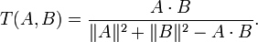
Video Fingerprint Project
How we do it (Algorithm, continued):
Tanimoto
Tanimoto makes a correlation with C and the remaining elements outside C
Vector distance
B
A
C

Slide 14
Video Fingerprinting
Example test (video capture from FujiTV):
24 hours video uses 45Gbytes in hard disk
MPEG-2 video captured at 720x480 29.97fps
Fingerprints of 24h of video use 2Mbytes in a DB

Slide 15
Video Fingerprinting
Output for Ito En Teas’ Tea ad from 7p.m. of 2009/11/18 to 7p.m. of 2009/11/19:
Looking for CM_teastea.mp4 (14 second clip):
100.00% Hit: Video segment found in 2009_11_18__19_06__FujiTV.mpg [6327~6340]
100.00% Hit: Video segment found in 2009_11_18__19_06__FujiTV.mpg [17267~17280]
95.83% Hit: Video segment found in 2009_11_18__19_06__FujiTV.mpg [19697~18710]
100.00% Hit: Video segment found in 2009_11_18__19_06__FujiTV.mpg [21312~21325]
100.00% Hit: Video segment found in 2009_11_18__19_06__FujiTV.mpg [21497~21510]
100.00% Hit: Video segment found in 2009_11_18__19_06__FujiTV.mpg [26937~26950]
100.00% Hit: Video segment found in 2009_11_18__19_06__FujiTV.mpg [27999~28012]
100.00% Hit: Video segment found in 2009_11_18__19_06__FujiTV.mpg [40689~40702]
100.00% Hit: Video segment found in 2009_11_18__19_06__FujiTV.mpg [58406~58419]
75.00% Hit: Video segment found in 2009_11_18__19_06__FujiTV.mpg [62623~62636]
Test run-time of 500.3 seconds
Similar results were achieved with advertisements from:
DoCoMo, Calbee, Biore, Asahi Kasei, Uniqlo, Sony, Softbank, KDDI, J!NS, Pantene, McDonalds

Slide 16
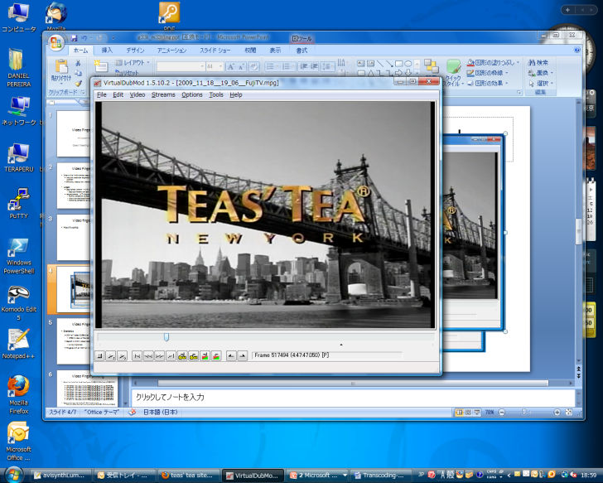
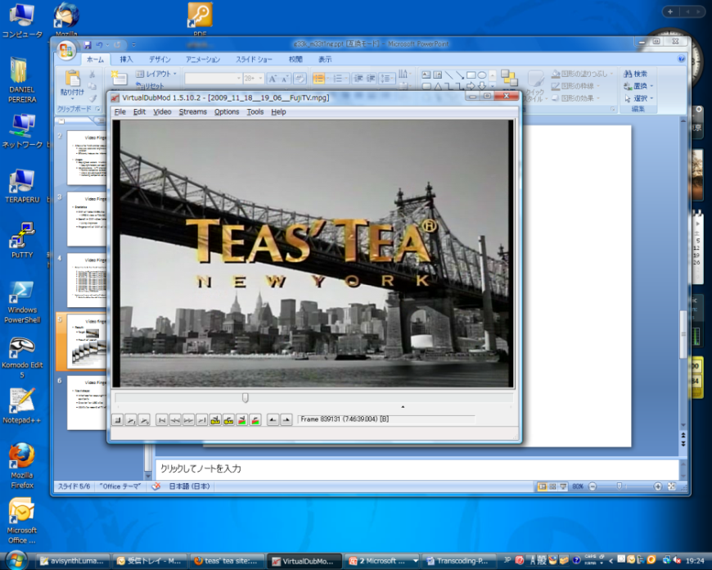
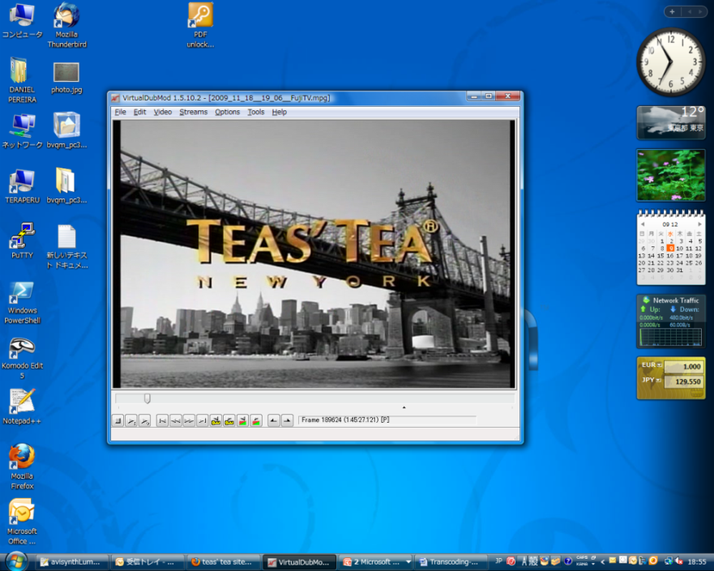
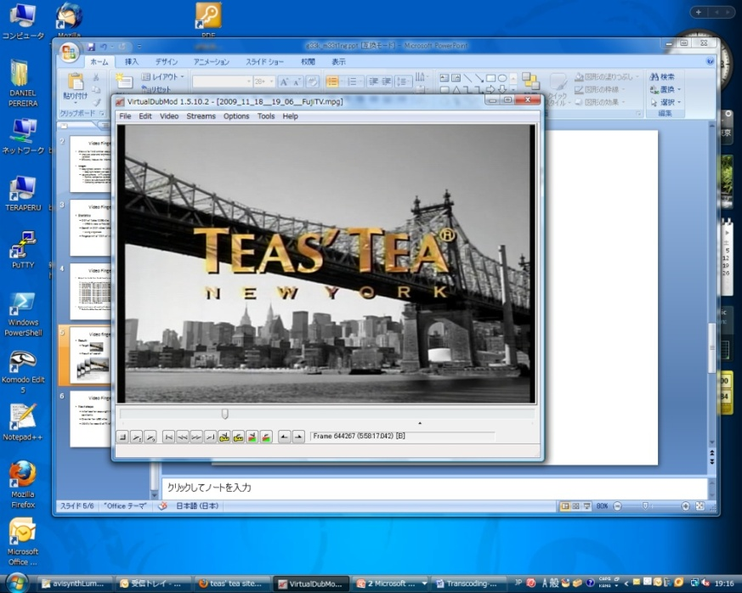


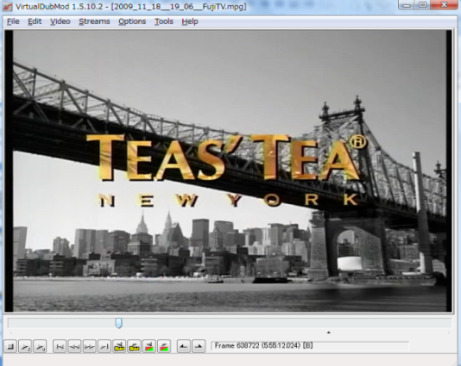


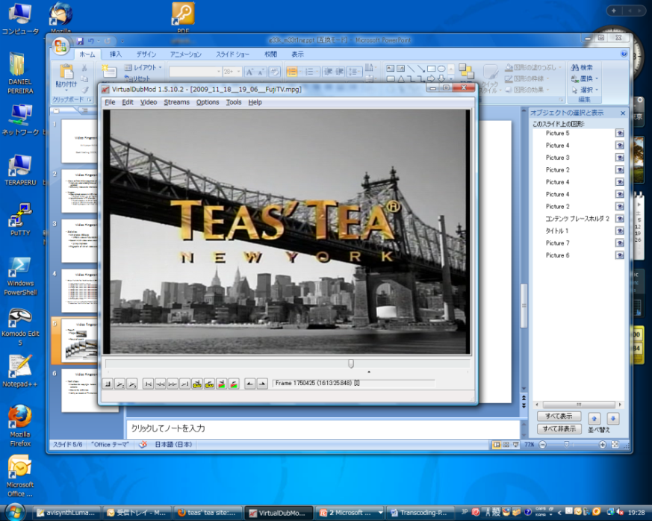
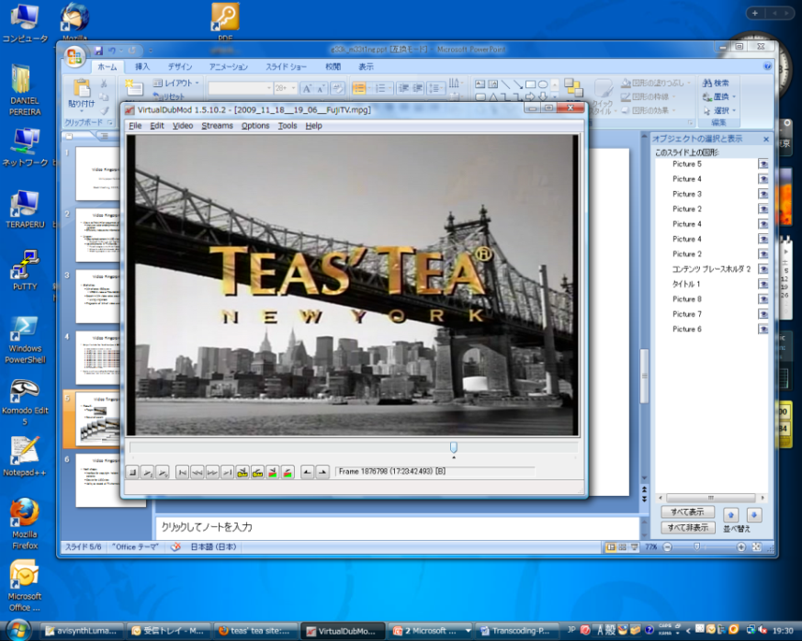
Video fingerprinting
Result:
Target:
Result of search:
7:00 pm 7:00 pm
8:45:27 11:47:47 0:28:17 0:55:12 2:28:57 6:18:08 11:13:25
0:58:17 2:46:39 12:23:42

Slide 17
Video Fingerprint Project
Related patents:
Eight new video fingerprinting patents found
Two very similar patents filled in USA and Europe
All patents were accepted within the past 4 months, most of them within the last month
Japanese patent submission is very tough
Needs innovative ideas with no prior art
Patents filled outside are considered prior art
The algorithm has been patented
Maybe some possibilities on the database side

Slide 18
Video Fingerprint Project
Thank you

